Slide 1
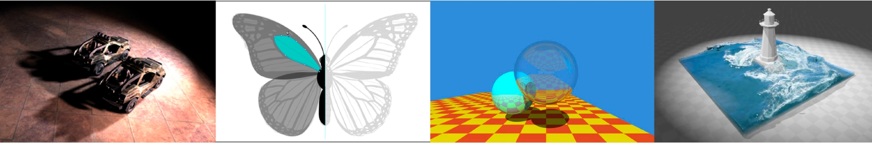
Introduction to Computer Graphics GAMES101, Lingqi Yan, UC Santa Barbara
Lecture 14:
Ray Tracing 2
(Acceleration & Radiometry)
http://www.cs.ucsb.edu/~lingqi/teaching/games101.html

Slide 2
Announcements
• Grading of resubmissions — we’re working on that
• GTC news: DLSS 2.0
- https://zhuanlan.zhihu.com/p/116211994
• GTC news: RTXGI
- https://developer.nvidia.com/rtxgi
• Personal feeling
- Offline rendering techniques will soon become real-time - Current real-time rendering techniques will still be useful
• Next lectures won’t be easy
GAMES101 2 Lingqi Yan, UC Santa Barbara

Slide 3
Last Lecture
• Why ray tracing?
• Whitted-style ray tracing
• Ray-object intersections - Implicit surfaces
- Triangles
• Axis-Aligned Bounding Boxes (AABBs)
- Understanding — pairs of slabs - Ray-AABB intersection
GAMES101 3 Lingqi Yan, UC Santa Barbara

Slide 4
Today
• Using AABBs to accelerate ray tracing
- Uniform grids
- Spatial partitions
• Basic radiometry (辐射度量学)
GAMES101 4 Lingqi Yan, UC Santa Barbara

Slide 5
Uniform Spatial Partitions (Grids)

Slide 6


Preprocess – Build Acceleration Grid
1. Find bounding box
GAMES101 6 Lingqi Yan, UC Santa Barbara

Slide 7

Preprocess – Build Acceleration Grid
1. Find bounding box
2. Create grid
GAMES101 7 Lingqi Yan, UC Santa Barbara

Slide 8
Preprocess – Build Acceleration Grid
1. Find bounding box
2. Create grid
3. Store each object
in overlapping cells
GAMES101 8 Lingqi Yan, UC Santa Barbara

Slide 9
Ray-Scene Intersection
Step through grid in ray traversal order
For each grid cell
Test intersection with all objects stored at that cell
GAMES101 9 Lingqi Yan, UC Santa Barbara

Slide 10
Grid Resolution?
One cell
• No speedup
Lingqi Yan, UC Santa Barbara
GAMES101
10

Slide 11
Grid Resolution?
Too many cells
• Inefficiency due to extraneous grid traversal
Lingqi Yan, UC Santa Barbara
GAMES101
11

Slide 12
Grid Resolution?
Heuristic:
• #cells = C * #objs
• C ≈ 27 in 3D
Lingqi Yan, UC Santa Barbara
GAMES101
12

Slide 13
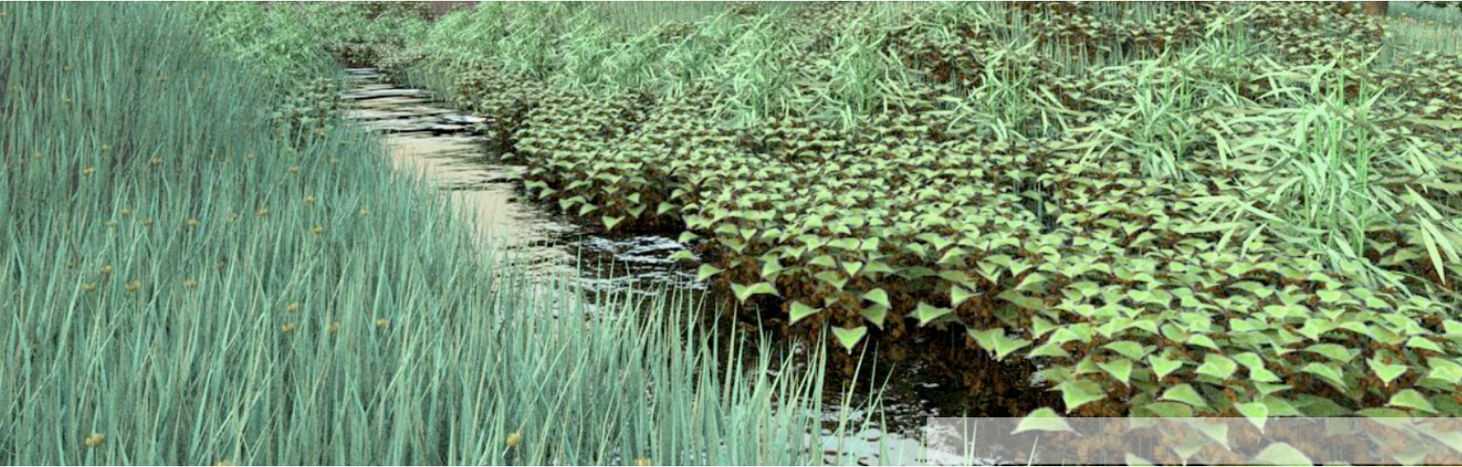
Uniform Grids – When They Work Well
Deussen et al; Pharr & Humphreys, PBRT
Grids work well on large collections of objects
that are distributed evenly in size and space
GAMES101 13 Lingqi Yan, UC Santa Barbara

Slide 14
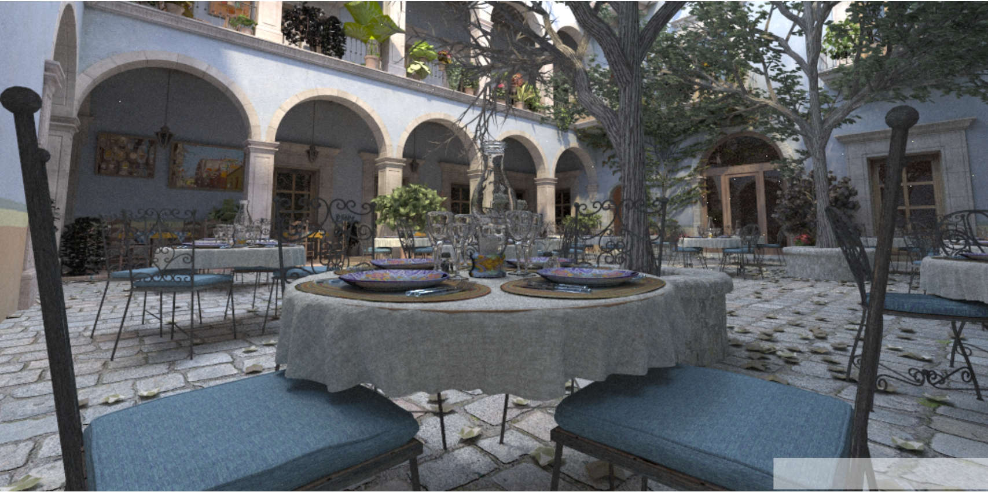
Uniform Grids – When They Fail
Jun Yan, Tracy Renderer
“Teapot in a stadium” problem
GAMES101 14 Lingqi Yan, UC Santa Barbara

Slide 15
Spatial Partitions

Slide 16
Spatial Partitioning Examples
Oct-Tree KD-Tree BSP-Tree
Note: you could have these in both 2D and 3D. In lecture we will illustrate principles in 2D.
GAMES101 16 Lingqi Yan, UC Santa Barbara

Slide 17
KD-Tree Pre-Processing
A
A
GAMES101 17 Lingqi Yan, UC Santa Barbara

Slide 18
KD-Tree Pre-Processing
A
B
B
A
GAMES101 18 Lingqi Yan, UC Santa Barbara

Slide 19
KD-Tree Pre-Processing
1 D | 2 C
 | 4 | B 3
 | 5
A
1 B
2 C
D 3
4 5
Note: also subdivide
nodes 1 and 2, etc.
A
GAMES101 19 Lingqi Yan, UC Santa Barbara

Slide 20
Data Structure for KD-Trees
Internal nodes store
• split axis: x-, y-, or z-axis
• split position: coordinate of split plane along axis
• children: pointers to child nodes
• No objects are stored in internal nodes
Leaf nodes store
• list of objects
GAMES101 20 Lingqi Yan, UC Santa Barbara

Slide 21
Traversing a KD-Tree
1 B
C B 2 C
D 3
D
A
4
5
GAMES101 21 Lingqi Yan, UC Santa Barbara

Slide 22
Traversing a KD-Tree
tmin
C
B
2
C
D 3
D
t
max
4
5
A Internal node: split
GAMES101 22 Lingqi Yan, UC Santa Barbara

Slide 23
Traversing a KD-Tree
tmin
t
max
1
C B 2 C
D 3
D 4 5
Assume it’s leaf node: intersect all objects
A
GAMES101 23 Lingqi Yan, UC Santa Barbara

Slide 24
Traversing a KD-Tree
tmin
1 B
C B 2 C
D 3
D
t
max
4
5
A Internal node: split
GAMES101 24 Lingqi Yan, UC Santa Barbara

Slide 25
Traversing a KD-Tree
tmin
1 B
t
max
C
2
C
B
D 3
D 4 5
Leaf node: intersect all objects
A
GAMES101 25 Lingqi Yan, UC Santa Barbara

Slide 26
Traversing a KD-Tree
1 B
C tmin B 2 C
D 3
D
t
max
4
5
A Internal node: split
GAMES101 26 Lingqi Yan, UC Santa Barbara

Slide 27
Traversing a KD-Tree
1 B
C
tmin
2
C
B
D
3
D
t
max
4
5
Leaf node: intersect all objects
A
GAMES101 27 Lingqi Yan, UC Santa Barbara

Slide 28
Traversing a KD-Tree
1 B
C thit B 2 D C 3
D 4 5
A Intersection found
GAMES101 28 Lingqi Yan, UC Santa Barbara

Slide 29
Object Partitions &
Bounding Volume Hierarchy (BVH)

Slide 30
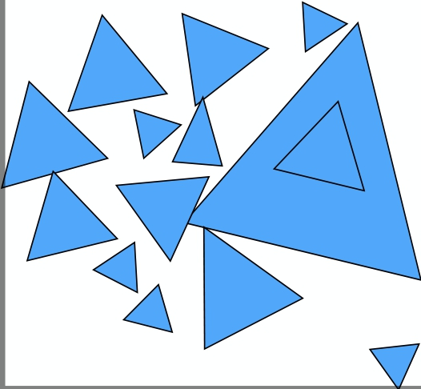

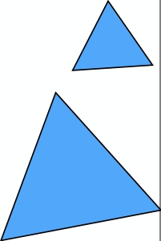
Bounding Volume Hierarchy (BVH)
Root
GAMES101 30 Lingqi Yan, UC Santa Barbara

Slide 31
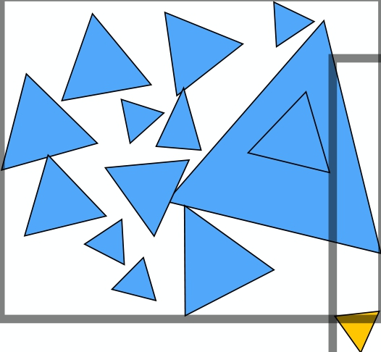

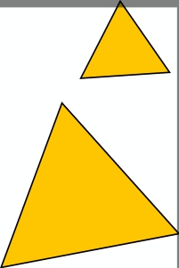
Bounding Volume Hierarchy (BVH)
GAMES101 31 Lingqi Yan, UC Santa Barbara

Slide 32
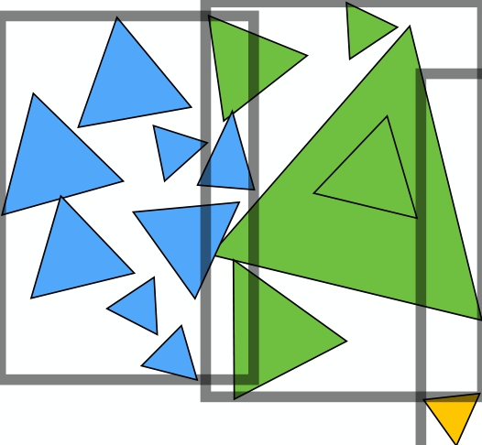

Bounding Volume Hierarchy (BVH)
GAMES101 32 Lingqi Yan, UC Santa Barbara

Slide 33
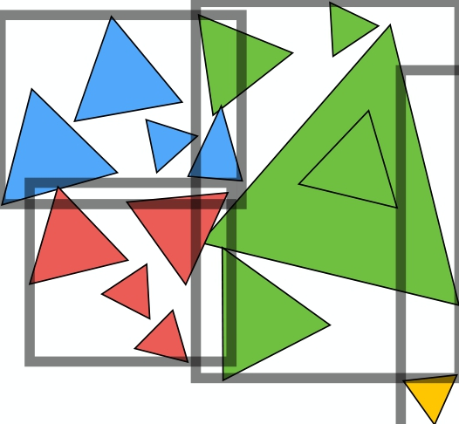
Bounding Volume Hierarchy (BVH)
C A
B
C D
D B A
GAMES101 33 Lingqi Yan, UC Santa Barbara

Slide 34


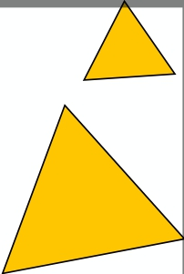
Summary: Building BVHs
• Find bounding box
• Recursively split set of
objects in two subsets
• Recompute the bounding
box of the subsets
• Stop when necessary
• Store objects in each leaf
node
Lingqi Yan, UC Santa Barbara
GAMES101
34

Slide 35
Building BVHs
How to subdivide a node?
• Choose a dimension to split
• Heuristic #1: Always choose the longest axis in node
• Heuristic #2: Split node at location of median object
Termination criteria?
• Heuristic: stop when node contains few elements
(e.g. 5)
GAMES101 35 Lingqi Yan, UC Santa Barbara

Slide 36
Data Structure for BVHs
Internal nodes store
• Bounding box
• Children: pointers to child nodes
Leaf nodes store
• Bounding box
• List of objects
Nodes represent subset of primitives in scene
• All objects in subtree
GAMES101 36 Lingqi Yan, UC Santa Barbara

Slide 37
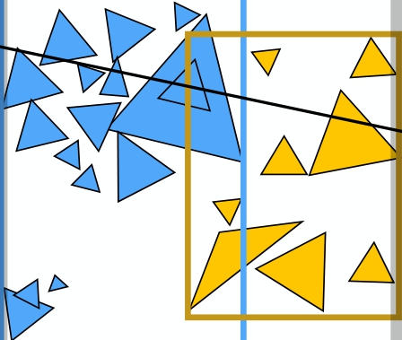
BVH Traversal
Intersect(Ray ray, BVH node) {
if (ray misses node.bbox) return;
if (node is a leaf node)
test intersection with all objs; return closest intersection;
hit1 = Intersect(ray, node.child1); hit2 = Intersect(ray, node.child2);
return the closer of hit1, hit2;
}
node
child1
child2
GAMES101 37 Lingqi Yan, UC Santa Barbara

Slide 38
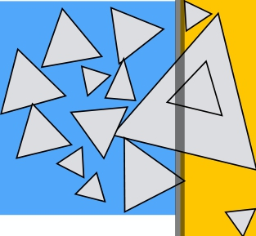


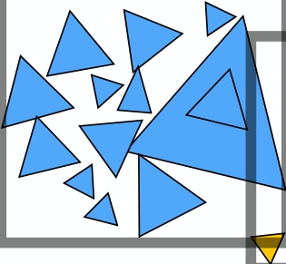

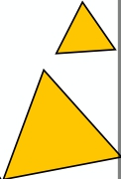
Spatial vs Object Partitions
Spatial partition (e.g.KD-tree)
• Partition space into
non-overlapping regions
• An object can be contained
in multiple regions
Object partition (e.g. BVH)
• Partition set of objects into
disjoint subsets
• Bounding boxes for each set
may overlap in space
GAMES101 38 Lingqi Yan, UC Santa Barbara

Slide 39
Today
• Using AABBs to accelerate ray tracing
- Uniform grids
- Spatial partitions
• Basic radiometry (辐射度量学)
- Advertisement: new topics from now on,
scarcely covered in other graphics courses
GAMES101 39 Lingqi Yan, UC Santa Barbara

Slide 40
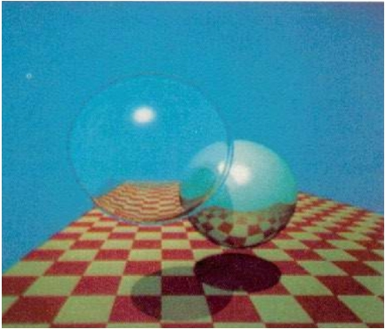
Radiometry — Motivation
Observation
• In assignment 3, we implement the Blinn-Phong model
• Light intensity I is 10, for example
• But 10 what?
Do you think Whitted style ray tracing gives you CORRECT results?
All the answers can be found in radiometry
• Also the basics of “Path Tracing”
GAMES101 40 Lingqi Yan, UC Santa Barbara

Slide 41
Radiometry
Measurement system and units for illumination
Accurately measure the spatial properties of light
- New terms: Radiant flux, intensity, irradiance, radiance Perform lighting calculations in a physically correct manner —————————————————————————
My personal way of learning things:
- WHY, WHAT, then HOW
GAMES101 41 Lingqi Yan, UC Santa Barbara

Slide 42
Radiant Energy and Flux (Power)

Slide 43
Radiant Energy and Flux (Power)
Definition: Radiant energy is the energy of electromagnetic radiation. It is measured in units of joules, and denoted by the symbol:
Q [J = Joule]
Definition: Radiant flux (power) is the energy emitted, reflected, transmitted or received, per unit time.
⌘ ddQt [W = Watt] [lm = lumen]*
GAMES101 43 Lingqi Yan, UC Santa Barbara

Slide 44
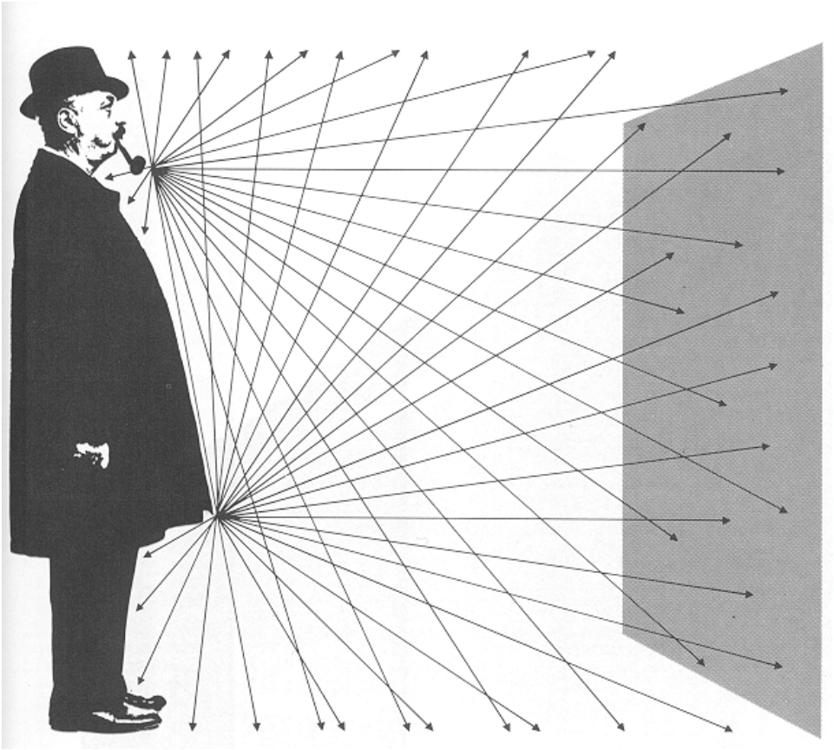
Flux – #photons flowing through a sensor in unit time
From London and Upton
GAMES101 44 Lingqi Yan, UC Santa Barbara

Slide 45
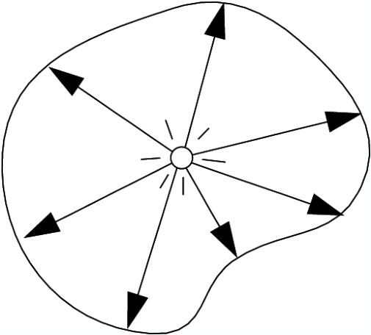
Important Light Measurements of Interest
Light Emitted
From A Source
Light Falling
On A Surface
Light Traveling
Along A Ray
“Radiant Intensity” “Irradiance” “Radiance”
GAMES101 45 Lingqi Yan, UC Santa Barbara

Slide 46
Radiant Intensity

Slide 47
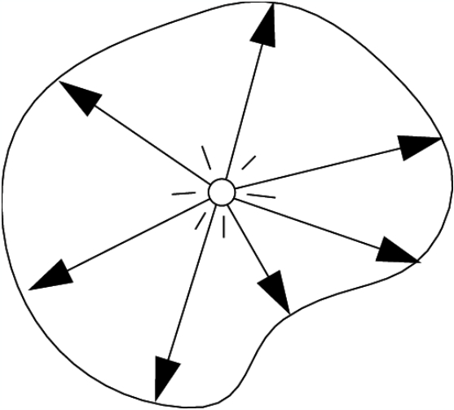
Radiant Intensity
Definition: The radiant (luminous) intensity is the power per unit solid angle (?) emitted by a point light source.
(⽴体⻆)
I(!) ⌘ d!


W
sr
lm
sr
= cd = candela
!
The candela is one of the seven SI base units.
GAMES101 47 Lingqi Yan, UC Santa Barbara

Slide 48
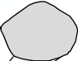
Angles and Solid Angles
Angle: ratio of subtended arc length
on circle to radius
• ✓ = l
r
• Circle has 2⇡ radians
l
✓
r
Solid angle: ratio of subtended area on sphere to radius squared
⌦ = A
•
r2
• Sphere has 4⇡ steradians
A
r
GAMES101 48 Lingqi Yan, UC Santa Barbara

Slide 49



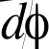

Differential Solid Angles
dA =(r d✓)(r sin ✓ d )
=r2 sin ✓ d✓ d
d! = dA r2
= sin ✓ d✓ d
GAMES101 49 Lingqi Yan, UC Santa Barbara

Slide 50
Differential Solid Angles
Sphere: S2
Z
⌦ = d!
S2
Z
Z
2⇡ ⇡
= sin ✓ d✓ d
0 0
=4⇡
GAMES101 50 Lingqi Yan, UC Santa Barbara

Slide 51
!
as a direction vector
! Will use ! to denote a
direction vector (unit length)
GAMES101 51 Lingqi Yan, UC Santa Barbara

Slide 52

Isotropic Point Source
Z
= I d!
S2
=4⇡I
I = 4⇡
GAMES101 52 Lingqi Yan, UC Santa Barbara

Slide 53
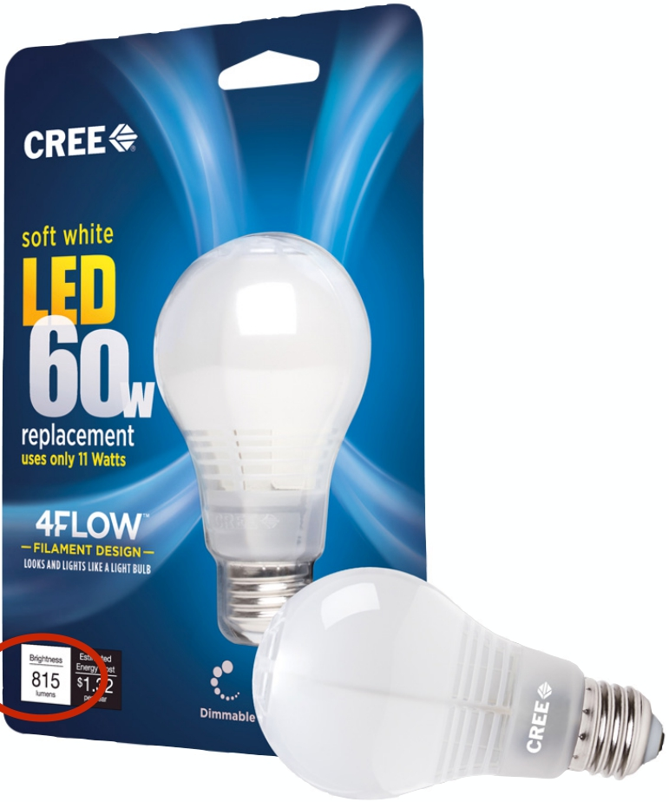
Modern LED Light
Output: 815 lumens
(11W LED replacement for 60W incandescent)
Radiant intensity?
Assume isotropic:
Intensity = 815 lumens / 4pi sr = 65 candelas
GAMES101
53
Lingqi Yan, UC Santa Barbara

Slide 54
Thank you!
(And thank Prof. Ravi Ramamoorthi and Prof. Ren Ng for many of the slides!)

